Slide 1

How to prepare a MASA enrollment benefit guide
Choose whether you want a 1-page version (slide 4) or a 2-page version.
Customize the tables (see restrictions and instruction in the notes section of that page or below)
Export the PPT to a PDF (File > Save as Adobe PDF > do save with the notes).
Name the guide for the company.
Restrictions & expectations
Removing of whole plans (columns) and corresponding benefits (rows) is acceptable, as long as table sizing is adhered to.
Adjusting benefit definitions is not approved.
Removing limits is not approved.
Removing the scannable QR codes which direct to the corresponding product guide is not approved.
Ensure the guide is coordinated to the state the company is sitused in before making adjustments.
Use of both pages in enrollment guides is expected. Page 1 educates while page 2 relates plan specifics.
New enrollment guides are expected to be prepared for annual enrollments.
Table customization instructions
To remove a plan column:
1. hover over the plan columns (vertical) you want removed until you see a downward bold black arrow — click and the column should be fully selected and highlighted.
2. Right-click inside of that column and select "delete" > "delete column" from the pop-up bar.
3. Check if there are any rows (horizontal) that need to be removed as a consequence of the plan removals and delete those using the same process. E.g., by eliminating the Premier plan, you don't need to show "Post admission coverage" or "Sick while away"
4. To make sure the table still looks good on the page, select the entire table, then go to the "Table layout" tab. Under "Table size" ensure that the width of the table is correct (either 5” or 7.5“).

Slide 3
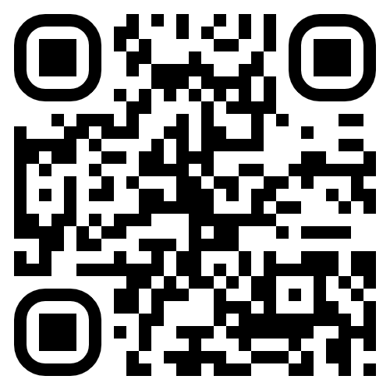
 |  | Emergency Shield Indemnity
Emergency Ground Ambulance Coverage If you ever need an emergency ground ambulance, MASA will pay you an indemnity amount for your eligible ride. |  | $2k indemnity per claim²
Emergency Air Ambulance Coverage If a first responder or doctor says air transport is medically necessary during your serious emergency, MASA will pay you an indemnity amount for your eligible flight. |  | $10k indemnity per claim, limit 2 per year²
Monthly protection rate |  | $11
Scan for product guide >>
Notes:
To customize the table see instructions below.
Reminders for adjustments:
Removing of whole plans (columns) and corresponding benefits (rows) is acceptable as long as table sizing is adhered to. See below.
Adjusting benefit definitions is not approved.
Removing limits is not approved.
Removing the scannable QR codes which direct to the corresponding product guide is not approved.
Ensure the guide is coordinated to the state the company is sitused in before making adjustments.
Table customization instructions:
To remove a plan column:
1. hover over the plan columns (vertical) you want removed until you see a downward bold black arrow — click and the column should be fully selected and highlighted.
2. Right-click inside of that column and select "delete" > "delete column" from the pop-up bar.
3. Check if there are any rows (horizontal) that need to be removed as a consequence of the plan removals and delete those using the same process. E.g., by eliminating the Premier plan, you don't need to show "Post admission coverage" or "Sick while away"
4. To make sure the table still looks good on the page, select the entire table, then go to the "Table layout" tab. Under "Table size" ensure that the width of the table is 7.5".

Slide 4

 |  | Emergency Shield Indemnity
Emergency Ground Ambulance Coverage If you ever need an emergency ground ambulance, MASA will pay you an indemnity amount for your eligible ride. |  | $2k indemnity per claim²
Emergency Air Ambulance Coverage If a first responder or doctor says air transport is medically necessary during your serious emergency, MASA will pay you an indemnity amount for your eligible flight. |  | $10k indemnity per claim, limit 2 per year²
Monthly protection rate |  | $11
Scan for product guide >>
Visit [insert enrollment site URL]
to learn more and enroll today!
Notes:
To customize the table see instructions below.
Reminders for adjustments:
Removing of whole plans (columns) and corresponding benefits (rows) is acceptable as long as table sizing is adhered to. See below.
Adjusting benefit definitions is not approved.
Removing limits is not approved.
Removing the scannable QR codes which direct to the corresponding product guide is not approved.
Ensure the guide is coordinated to the state the company is sitused in before making adjustments.
Table customization instructions:
To remove a plan column:
1. Hover over the plan columns (vertical) you want removed until you see a downward bold black arrow — click and the column should be fully selected and highlighted.
2. Right-click inside of that column and select "delete" > "delete column" from the pop-up bar.
3. Check if there are any rows (horizontal) that need to be removed as a consequence of the plan removals and delete those using the same process. E.g., by eliminating the Premier plan, you don't need to show "Post admission coverage" or "Sick while away"
4. To make sure the table still looks good on the page, select the entire table, then go to the "Table layout" tab. Under "Table size" ensure that the width of the table is 5".
Don’t forget to fill in the colorful box with the enrollment site information. This is also removable if you prefer.

